Slide 1

Python for Geospatial Big Data and Data Science Using the FASRC
Robert Spang
Visiting Scholar, Centre for Geographic Analysis, Harvard University
Quality and Usability Lab, Technical University of Berlin, Germany
Devika Kakkar and Xiaokang Fu
Centre for Geographic Analysis, Harvard University

Slide 2
Chapter 1
Introduction
Python for Geospatial Big Data and Data Science Using the FASRC

Slide 3
Who we are
Robert Spang
TU Berlin, visiting scholar with the CGA
Devika Kakkar
Data Science Project Manager
Xiaokang Fu
Postdoctoral Fellow

Slide 4
Who are you?
Short round of introduction
Your name and field of research
Why are you here? What do you hope to take away from this workshop? What do you want to use HPC for?
What’s your tech / programming / data science experience level?
Have you worked with the FASRC before?
command line?

Slide 5
Files & Data for the Workshop
Files
Slides, exercises, command cheat sheet, and code files
GitHub: [TODO]
Datasets
All data we’ll work with
Publicly accessible on the cluster: /n/holyscratch01/cga/rspang/workshop_data/
Harvard’s Dataverse: [TODO]

Slide 6
Introduction to Big Data Processing & HPC
Big Data
Volume, Velocity, and Variety (3Vs)
Also: Veracity and Value
Processing
Large dataset → aggregated results → smaller datasets
Faculty of Arts and Sciences Research Cluster
Harvard’s High-Performance Cluster (HPC)
Notes:
Big Data refers to data sets that are so large, varied, or complex that they challenge the capacity and capabilities of conventional data processing systems and techniques. Key attributes often associated with Big Data are the 3Vs:
Volume: The sheer size of the data. This is the most direct attribute, referring to the massive scale of data, often in petabytes or exabytes.
Velocity: The speed at which new data is generated and collected. This could be high-frequency trading data, social media posts, sensor data, etc., that is generated every millisecond of every day.
Variety: Refers to the different types of data. This can include structured data (like databases), unstructured data (like text), and semi-structured data (like XML or JSON).
Over time, additional Vs have been proposed, like Veracity (the reliability of data) and Value (the usefulness of data), but the core challenge of Big Data revolves around storage, querying, analysis, sharing, transfer, visualization, updating, and information privacy.
It's essential to understand that the challenges of Big Data aren't just about size, but also about the infrastructure, tools, and algorithms required to handle, process, and derive insights from the data.
Processing refers to working with the data, mostly in terms of reducing it to an easier to handle subset or results that can then be further processed elsewhere (e.g. on a client side app), or for it to be communicated in texts, websites, or reports. Such analyses usually are about filtration and aggregation.
FASRC is an acronym for the Faculty of Arts and Sciences Research Cluster; Harvard's High-Performance Cluster (HPC) for scientific computation. While the FASRC is open to anyone at Harvard, you might want to use large scale computing infrastructure even after you finish your work here. Cloud Computing comes to mind, so let's briefly distinguish what an HPC offers from what cloud computing is mostly designed for. Both Cloud Computing and HPC are paradigms that leverage multiple computers to achieve specific computational goals, but they cater to different needs and have distinct characteristics.

Slide 7
Differences between a HPC & the Cloud
Purpose
Architecture
Resource Allocation
Usage and Applications
Flexibility
Economic Model
Location
Notes:
Purpose:
Cloud Computing: Primarily aimed at delivering on-demand computing resources over the internet on a pay-as-you-go basis. The primary goal is scalability, flexibility, and resource sharing.
High-Performance Clusters (HPC): Primarily focused on delivering supercomputing capabilities for intensive tasks that require significant computational power, such as simulations, scientific research, and high-frequency trading. The goal is maximum performance for specific, computationally intensive tasks.
Architecture:
Cloud Computing: Often built on distributed systems and virtualized resources. This architecture allows for dynamic resource allocation based on demand.
HPC: Typically built with a cluster of tightly-coupled, high-performance computers that work in parallel to achieve maximum computational throughput. Often, HPC environments use supercomputers or grids to achieve this.
Resource Allocation:
Cloud Computing: Resources like storage, CPU, and memory are typically virtualized, allowing them to be easily scaled up or down based on demand.
HPC: Resources are often meticulously configured and optimized for specific tasks to ensure maximum performance. There's less emphasis on dynamic scalability compared to Cloud environments.
Usage and Applications:
Cloud Computing: Used for a variety of services like Software as a Service (SaaS), Platform as a Service (PaaS), and Infrastructure as a Service (IaaS). Examples include web hosting, data storage services, and application hosting.
HPC: Predominantly used for tasks requiring intensive computational power, like fluid dynamics simulations, genomic research, or large-scale data processing and analysis.
Flexibility:
Cloud Computing: Offers high flexibility with the ability to quickly deploy, scale, or reduce resources. It can cater to a wide range of applications and services.
HPC: Generally, less flexible compared to cloud environments, as they are specifically optimized and configured for dedicated tasks.
Economic Model:
Cloud Computing: Typically employs a pay-as-you-go model, where users pay only for the resources they consume.
HPC: The economic model varies, but these systems often involve substantial upfront investment in hardware and infrastructure.
Location:
Cloud Computing: Resources can be distributed across various locations, often across different data centers and regions globally.
HPC: Systems are typically colocated in a single location or data center, optimizing for low-latency communication between nodes.
In summary, while both Cloud Computing and HPC leverage the power of multiple computers, they serve different needs and have distinct operational and architectural differences. Cloud Computing emphasizes flexibility and scalability, while HPC focuses on achieving maximum computational performance for specific tasks.

Slide 8
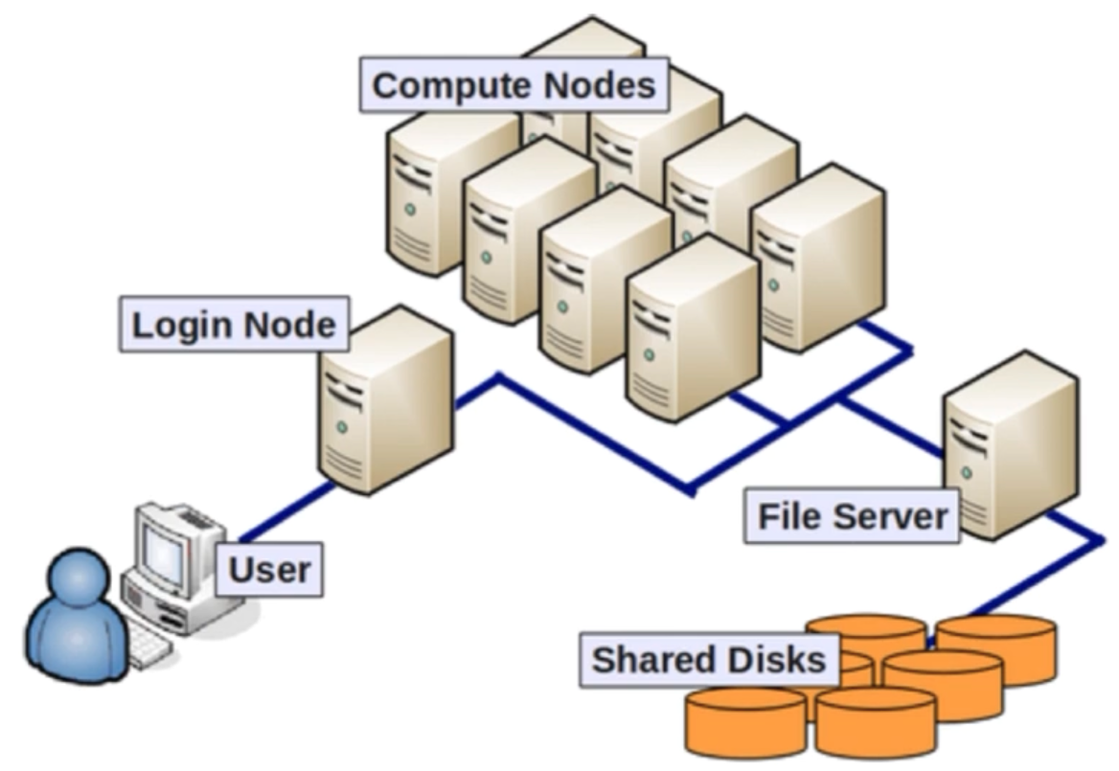
Structure of the FASRC – Structure
Access the cluster through a “login node”
ssh user@login.rc.fas.harvard.edu
From there, connect to compute nodes to run apps
Login nodes are not designed for anything compute/memory intensive
Source: https://www.youtube.com/watch?v=Ay8oR5n-yyQ

Slide 9
Structure of the FASRC – SLURM
SLURM is a job scheduler
Specify the resources needed, get a node allocated
Specify node-type, CPU cores, memory, and runtime
A job terminates after the designated time is up
SLURM ensures users do not exceed resource request
Mostly used to queue jobs, but can also run an interactive session
srun –-pty –p test –mem 100 –t 0-01:00 /bin/bash
Notes:
SLURM – Simple Linux Utility for Resource Management
Command:
srun –pty: Request an interactive session
-p test: the compute node should be of the test-class
--mem 100: request 100MB of memory
-t 0-1:00: request the session for one hour

Slide 10
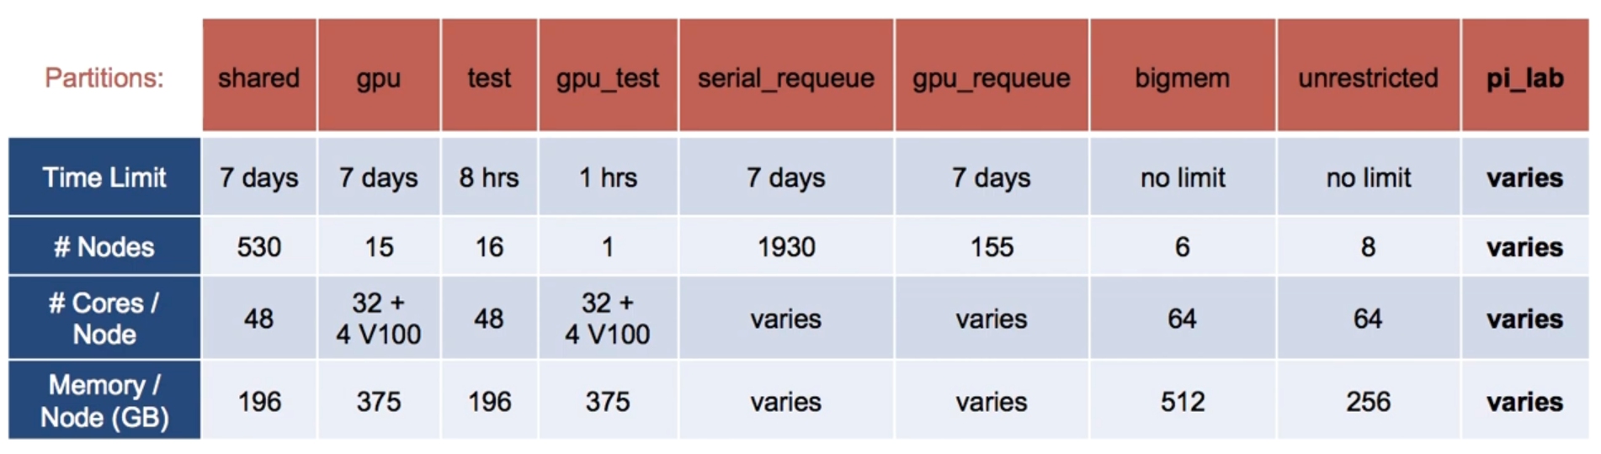
Structure of the FASRC – Partitions
Partitions are the different node-classes
Each class comes with different attributes for different use-cases
Source: https://www.youtube.com/watch?v=Ay8oR5n-yyQ

Slide 11
Structure of the FASRC – Storage
Two sites with different networks
Consider where to up-/download data
Tools e.g. rsync, scp, …
Login-nodes are are suitable for most application (10Gb/s)
For large data sets, make sure to use a cable connection (instead of e.g. EDUROAM WiFi)

Slide 12
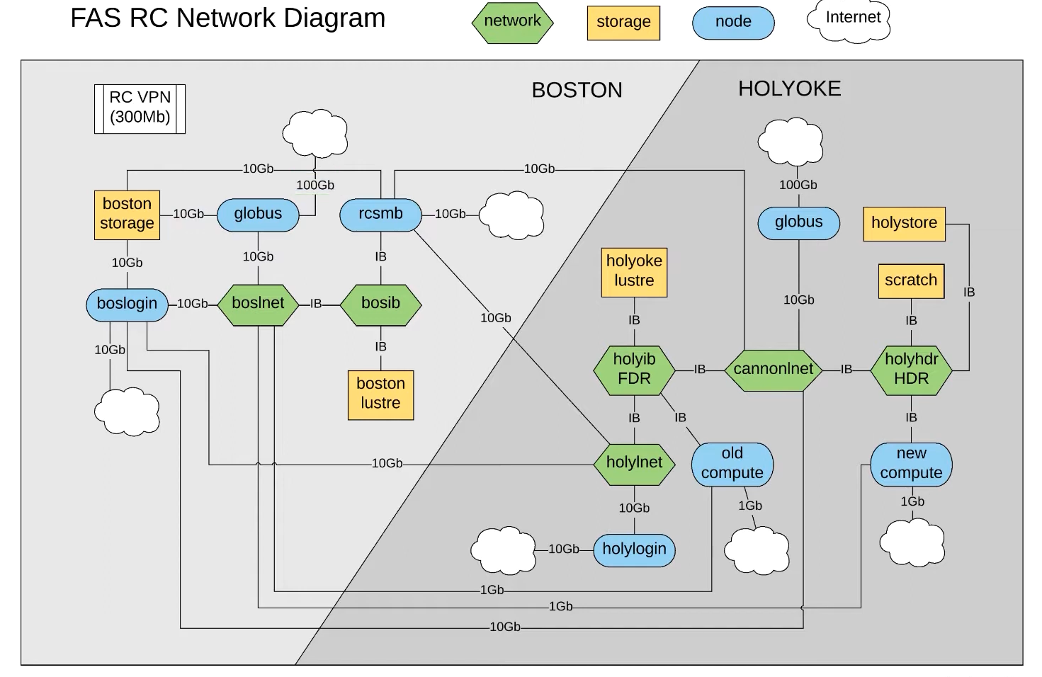
Source: https://www.youtube.com/watch?v=n1I4-4TGVP8

Slide 13
Structure of the FASRC – Storage
Home directory is your primary, private space
100GB
Moderate performance, not suitable for heavy I/O
Local (node) scratch
/scratch
200-300GB/node (shared with all users on the node!)
Lives for job duration
Global scratch
/n/$SCRATCH
2.4PB (shared with everyone on the cluser)
Lives for 90 days
Notes:
Scratches are great to work with, but copy results to your private space after your job is done

Slide 14
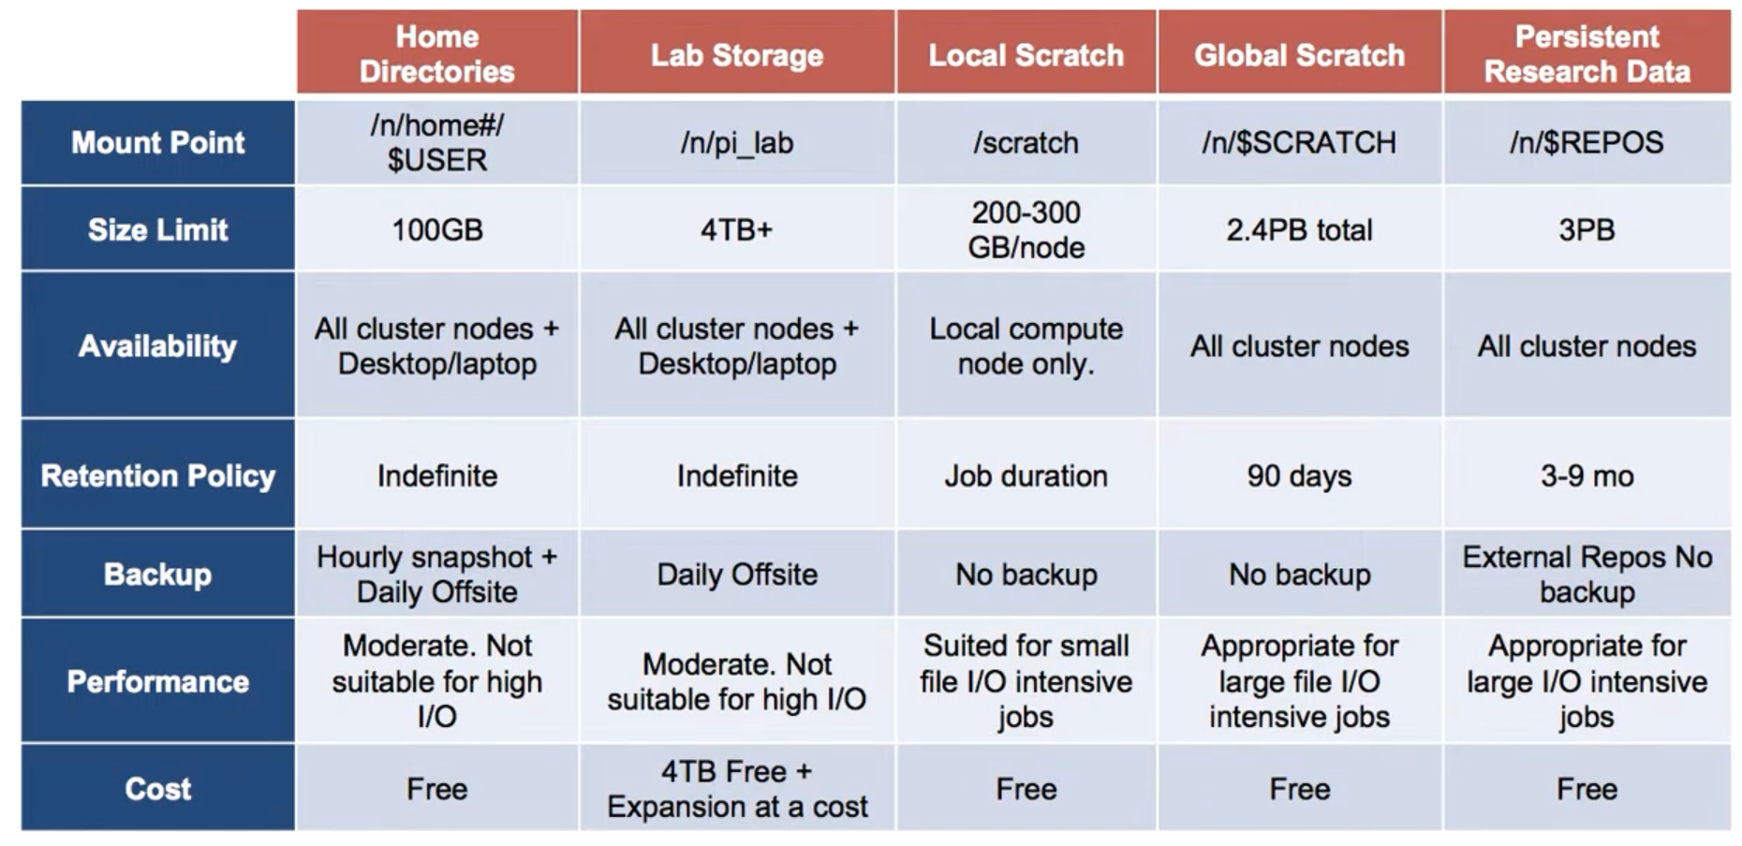
Source: https://www.youtube.com/watch?v=rGH96xVQNyM

Slide 15
Code of Conduct
Shared resources
Expect > 800 users of the RC
Your actions might influence others’ experiences
Request only the resources you need
Login nodes only to login, to submit jobs and to receive data
Consider the right storage space for each task

Slide 16
Exercise I - Web
Login to the FASRC web interface
https://rcood.rc.fas.harvard.edu/
Start an interactive Jupyter notebook session
Default settings are ok
In Jupyter, create a new Python Notebook, name it test.ipynb
Run a simple demo code (e.g. print("Hello World"))

Slide 17
Exercise II - CLI
Login to the cluster via SSH
ssh user@login.rc.fas.harvard.edu
Setup a python environment
Load the Python / mamba module
module load Mambaforge/23.3.1-fasrc01
Create a new mamba environment
mamba create -n workshop python=3.9 --file requirements.txt

Slide 18
Exercise II - CLI
Start an interactive shell on a compute node
srun --pty -p test --mem 1000 –c 2 -t 0-01:00 /bin/bash
Load Python module & start environment
module load Mambaforge/23.3.1-fasrc01
mamba activate workshop
Run Python code
jupytext --to py test.ipynb # convert .ipynb to .py
python test.py

Slide 19

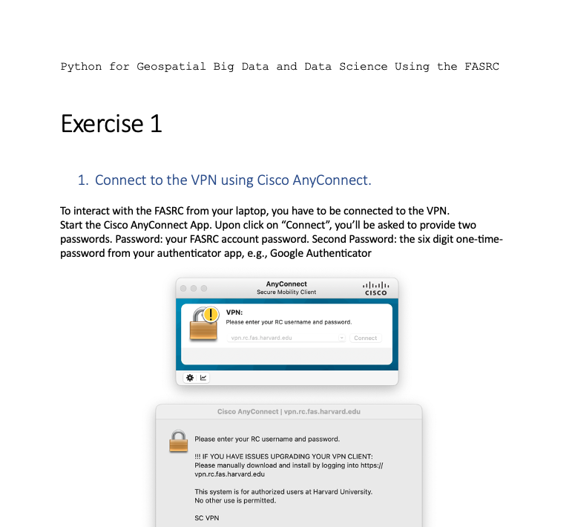
Exercise
Find the exercise document in the GitHub repo

Slide 20
Chapter 1
Questions & Comments?
5min coffee break

Slide 21
Chapter 2
Basics of Big Data Software Development
Python for Geospatial Big Data and Data Science Using the FASRC

Slide 22
Environment Differences: Local vs. HPC
Parallelism
Memory
Storage
Environment and Dependencies
Batch Systems
Data Transfer
Error Handling and Debugging
Optimizations
Networking
Code Scalability
Notes:
Programming for a High-Performance Computing (HPC) environment can be quite different from doing so on a local machine. When designing and executing data analyses in these two contexts, you might consider the following factors:
Parallelism:
Local Machine: Typically limited to the number of cores on your machine, which is generally low (e.g., 4, 8, 16 cores). You might use libraries like multiprocessing for parallel processing.
HPC: HPC clusters typically have a much larger number of cores, and may even span multiple nodes. You'd probably use MPI (Message Passing Interface) libraries like mpi4py or distributed computing libraries/frameworks like Dask.
Memory:
Local Machine: You're constrained by the RAM on your machine, which can be a limiting factor for large datasets.
HPC: Distributed memory across nodes means you can handle much larger datasets, but you also need to manage data distribution and communication.
Storage:
Local Machine: You generally access data from local drives or connected network drives.
HPC: HPC environments usually have shared filesystems like Lustre or GPFS. I/O operations can be a bottleneck, so you might need to optimize data reading/writing or consider using local scratch space on the nodes.
Environment and Dependencies:
Local Machine: You can generally install libraries and tools as needed.
HPC: HPC systems may have strict software modules and may not allow you to install packages at will. You may need to work with administrators or use virtual environments/containers like Singularity.
Batch Systems:
Local Machine: Direct execution of scripts.
HPC: Most HPCs use batch systems like SLURM, PBS, or Torque. You have to submit jobs to a queue, and there's often a need to specify resources (CPU, memory, time).
Data Transfer:
Local Machine: Data is usually locally available or downloaded from the web.
HPC: You might need to transfer data to/from the HPC system using tools like scp, rsync, or Globus.
Error Handling and Debugging:
Local Machine: Direct feedback, easy debugging with tools like pdb.
HPC: Debugging can be more challenging. Direct feedback is limited. It's crucial to have good logging and perhaps use remote debugging tools or debugging profiles available on the cluster.
Optimizations:
Local Machine: General performance optimizations.
HPC: You might need to consider node-level optimizations, inter-node communication, optimizing for specific architectures, or using GPU nodes if available.
Networking:
HPC: If your analysis requires communication between nodes, you need to be aware of the network topology and costs associated with data transfer between nodes.
Code Scalability:
Local Machine: Code is often written for single-node, multi-core scalability.
HPC: You should think about multi-node, multi-core scalability. It's not just about running faster; it's about scaling to much larger data sizes or problem complexity.

Slide 23
Toy Example & Scaling
Understand the problem
And all data sets involved
Develop a toy example
“Vertical prototype”
Solve the problem using a manageable subset of the data
Allows you to work on your local machine
Faster development iterations
Your favorite development environment
Notes:
Understand the dataset and the problem we will solve. Use a toy example to create a prototype of your analysis on a small subset of the data. This allows you to iterate quickly and learn how to work with the dataset. The size should be so small that you can comfortably work locally on your own machine, but large enough to "encounter most difficulties" (e.g. matching names) and to identify performance problems.

Slide 24
Toy Example & Scaling
Transfer toy example to HPC environment
Test if everything works as expected
“Fail fast, fail often”
Note differences: stdout, error messages, results, …
Scale to the entire dataset
Allocate HPC resources
Notes:
Understand the dataset and the problem we will solve. Use a toy example to create a prototype of your analysis on a small subset of the data. This allows you to iterate quickly and learn how to work with the dataset. The size should be so small that you can comfortably work locally on your own machine, but large enough to "encounter most difficulties" (e.g. matching names) and to identify performance problems.

Slide 25
Code Optimization
Optimize your code
Efficiency regarding I/O, memory, and storage
Use parallelization if possible
Choose the toy example to represent (most) challenges
Notes:
Optimize your local code. What's slow in your toy example won't scale well using the entire dataset. When working with large datasets, making efficient use of resources is very important. On a regular computer, this means writing efficient code, using memory and storage efficiently, and leveraging all CPU cores.
Rule of thumb: I/O is slow. Think about how often files need to be loaded into memory. Can you reuse them? Ideally, each file is loaded only once, then processed and an interim result is stored and the file never has to be touched again (exception: huge files that can't be loaded into memory).
Parallelization: Think about which part of the script is very compute intense and requires a long time to run? Can this part be parallelized? Doesn't have to be the entire script, but often there are some sections that are particularly resource intense.

Slide 26
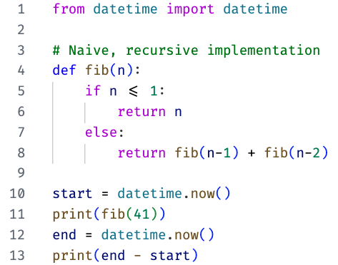
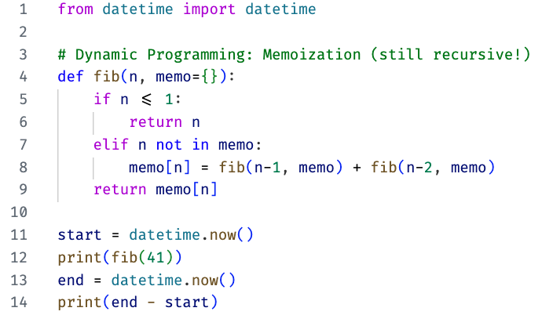
Code Efficiency: Dynamic Programming
Example: computing the Fibonacci sequence
Fib(41) ~ 31sec
Fib(41) ~ 0.000094sec
Fib(112) ~ age of the universe
Fib(120) ~ 0.000112sec
Notes:
Dynamic programming is a strategy for efficiently solving problems that exhibit the property of overlapping subproblems, by breaking them down into smaller, more manageable pieces. It involves solving the smallest and simplest subproblems first, storing their solutions, and then using these stored solutions to construct solutions for larger subproblems, thereby avoiding redundant calculations.
In this example, the naive recursive approach has exponential time complexity, while the dynamic programming approaches have linear time complexity, showcasing how adopting a different programming paradigm (dynamic programming) can significantly optimize the performance of Python code.
The naive recursive implementation of the Fibonacci sequence does, in fact, have exponential time complexity, not quadratic. The reason is that each call to fib(n) results in two further calls: fib(n-1) and fib(n-2), forming a binary recursion tree. This leads to a time complexity of O(2n)O(2n), which is exponential.
The memoization approach, also known as "top-down dynamic programming," has a linear time complexity, O(n)O(n), for calculating Fibonacci numbers. In this approach, each Fibonacci number is calculated only once, and the results are stored in a table (usually implemented as an array or a dictionary) for future reference.
https://en.wikipedia.org/wiki/Fibonacci_sequence

Slide 27
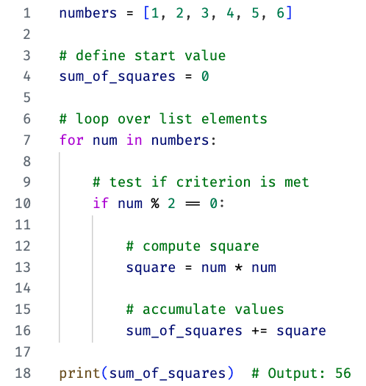
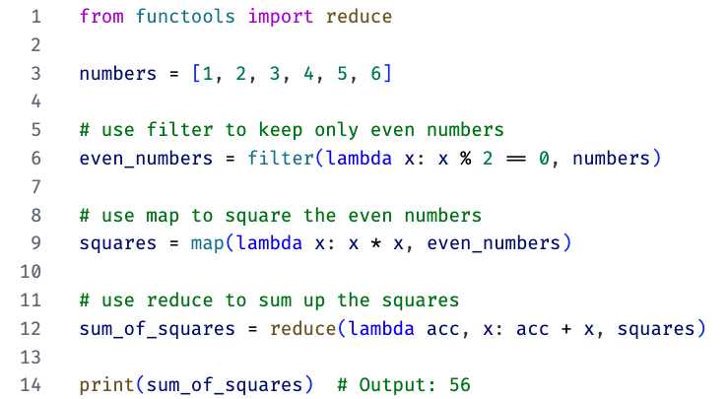
Code Efficiency: Filter / Map / Reduce
Example: sum of squares of even numbers from a list
Notes:
Functional programming paradigms can make it easier to parallelize code, as operations like map and filter can theoretically be applied to elements in parallel. This would involve further libraries and frameworks, such as Apache Spark.

Slide 28
Code Efficiency: Parallelization
Use multi-core CPUs
By default, a Python script runs on a single core
Modern CPUs have multiple cores → distribute load
Simple example: summing a large list of numbers
[1] -> [2] -> [3] -> [4] -> [5] -> [6] -> ... -> [N]
\___ Worker (CPU Core 1) moving sequentially, summing up.
Segment 1 Segment 2 Segment 3 Segment k
[1] -> [2] [3] -> [4] [5] -> [6] ... [N-1] -> [N]
\___ Worker 1 \___ Worker 2 \___ Worker 3 \___ Worker k

Slide 29

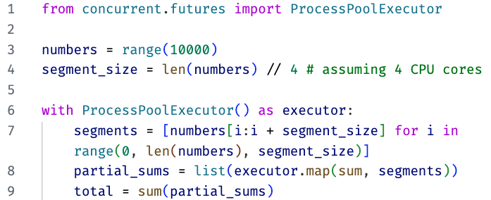
Code Efficiency: Parallelization
Example: summing a large list of numbers
Serial computing
Parallel computing

Slide 30
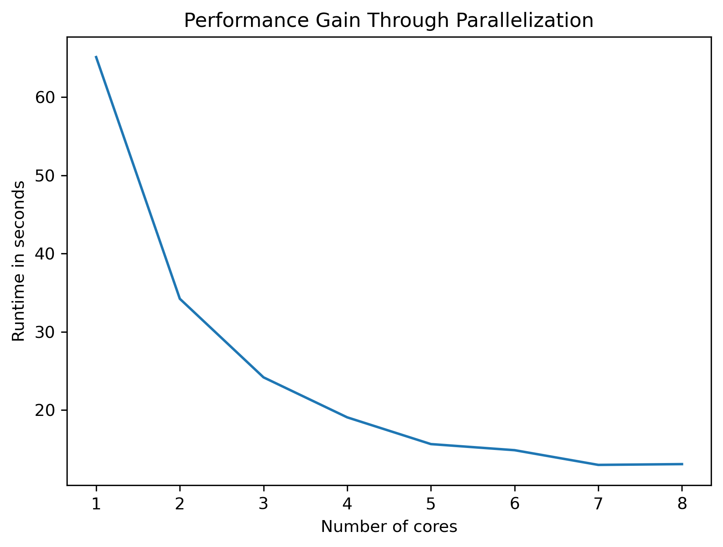
Code Efficiency: Parallelization
# Cores | Runtime in sec | Speedup
1 | 65.10 | 1.00
2 | 34.21 | 1.90
3 | 24.17 | 2.69
4 | 19.06 | 3.42
5 | 15.64 | 4.16
6 | 14.86 | 4.38
7 | 12.98 | 5.01
8 | 13.08 | 4.98
Notes:
Comparison of speedup through parallelization on a laptop (MacBook Pro, M1 Pro, 8 performance cores)
Task: Augment a tweet-table having 642,936 rows with precipitation values for each respective day and location. Values are averages of five runs.
The speedup won't grow linearly as the overhead of managing many processes increases.
Best performance is achieved as long as a little computing power is left to orchestrate the processes (< num max cores).
While this is a rule of thumb, this is also task and implementation dependent.

Slide 31
Scaling on a HPC
Vertical scaling
Using more resources on a node
“scaling up”
Horizontal scaling
Growing the system by connecting multiple hardware entities to distribute the load across nodes
“scaling out”
Notes:
On a high performance cluster, all the considerations for local optimization are important as well, but there is an additional dimension to scale to: Here, we have multiple computers (nodes). So a task cannot only be distributed among cores, but among nodes and the many cores of each node. However, this comes with additional challenges in distributing the load: Supervising nodes and processes and distributing data and results across a network.
Make the common case fast
While a HPC environment offers the highest possible performance, it requires a lot of engineering to optimize code for such environments. Using the toy example approach, can you engineer the script locally on your computer and then run the dig data part only once? If so, don't spend too much time engineering the perfect Big Data workflow.
→ This is mostly the case; e.g. analyzing a big dataset to answer a research question: start with a toy example locally, then run it once on the cluster. It's perfectly fine if you start 20 scripts manually that each run only once. This is still much faster than spending too much time automating everything perfectly.
That being said, not all tasks are like that. While this holds true for many static dataset tasks, there are projects that are based on e.g. continuous datasets, e.g. a pandemic dashboard. Here, you have constant streams of data, and the execution is never "done". Here it is crucial to employ fully automated workflows (and use frameworks to distribute loads across nodes and cores, e.g. Apache Spark).
In our example today, we work with one large, static dataset to answer one research question. While it would be possible to do that on a local machine, it would run for many hours, probably days. This gives us the opportunity to explore best practices locally and remotely on the cluster, to engineer our scripts with the convenience we're used to and also leverage the performance of a remote cluster.

Slide 32
Monitoring
Monitor the load on a system
Command: htop, or command: ps –U username
E.g. run a job in an interactive session; have a second SSH connection to monitor the load
List running SLURM jobs
Command: squeue
Monitor if a job is (still) running from a login node

Slide 33
Exercise
Run a Python program on a compute-node
python mp_sleep.py
Monitor multiple processes using htop
While the program is running on a compute-node, open https://rcood.rc.fas.harvard.edu/pun/sys/shell/ssh/COMPUTE_NODE.rc.fas.harvard.edu in a browser; replace “COMPUTE_NODE” with the node-ID you are connected to

Slide 34

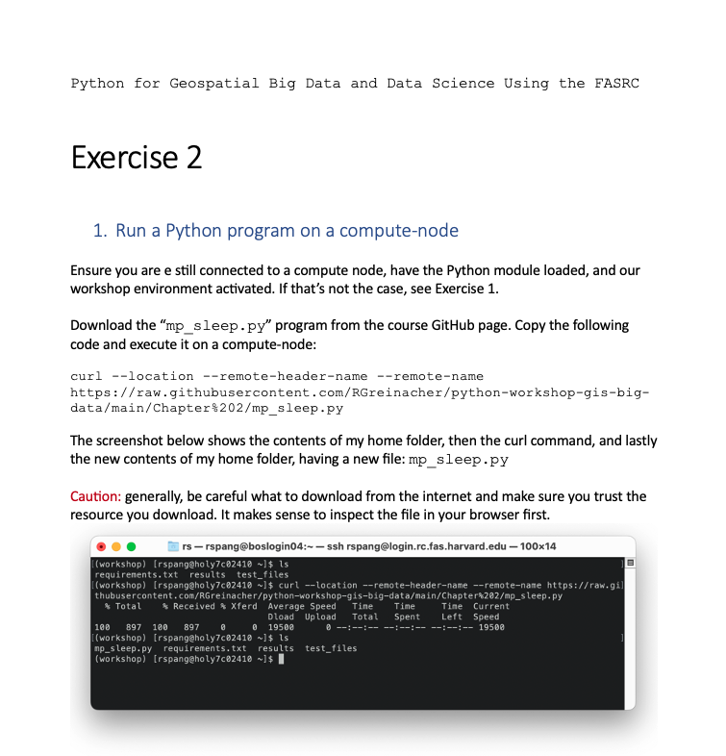
Exercise
Find the exercise document in the GitHub repo

Slide 35
Chapter 2
Questions & Comments?
5min coffee break

Slide 36
Chapter 3
Introduction to the Case Study
Python for Geospatial Big Data and Data Science Using the FASRC

Slide 37
Chapter 3
Questions & Comments?
1h lunch break

Slide 38
Chapter 4
Efficient Programming
Python for Geospatial Big Data and Data Science Using the FASRC

Slide 39
Chapter 4
Questions & Comments?
5min coffee break

Slide 40
Chapter 5
Moving to the FASRC
Python for Geospatial Big Data and Data Science Using the FASRC

Slide 41
Chapter 5
Questions & Comments?
5min coffee break

Slide 42
Chapter 6
Recap, Wrap-up & Outro
Python for Geospatial Big Data and Data Science Using the FASRC

Slide 43
Inspirations: CGA’s Big Data Projects
Complex geospatial analysis
Geospatial big data cannot be handled by traditional GIS
Scale geospatial applications on cluster (FASRC) and cloud (AWS/MOC) computing environments
Geospatial databases (PostGIS, OmniSci)
Visualization of large geospatial data using GPU databases
→ https://gis.harvard.edu/gis-data-science-big-data-workstream-cga

Slide 44
Chapter 6
Questions & Comments?
Thank you for joining us!

